Slide 1
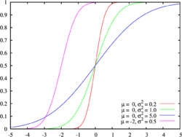
Cumulative Frequency

Slide 2
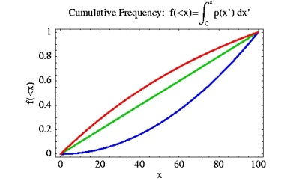
Starter
Work out the group with the median value for each of the following sets of data (median value = total + 1, divided by 2)
Goals | Frequency
0 | 8
1 | 13
2 | 13
3 | 6
4 | 4
Handspan (cm) | Quantity
10 – 12 | 12
12 – 14 | 18
14 – 16 | 23
16 – 18 | 20
18 – 20 | 7
(8)
(12)
(21)
(30)
(34)
(53)
(40)
(73)
(44)
(80)
Total = 44
Total = 80
44 + 1 = 45
80 + 1 = 81
45 ÷ 2 = 22.5th value
81 ÷ 2 = 40.5th value

Slide 3
Cumulative Frequency
Today we will be learning about Cumulative Frequency
We will learn how to plot a Cumulative Frequency curve and some interpretations of it

Slide 4
Cumulative Frequency
Draw a Cumulative Frequency Curve of the following information
Cumulative Frequency is also called a ‘running total’
Estimate the number of days with a temperature below 75°F
Temperature (˚F)
50 -
60 -
70 -
80 -
90 - 100
Frequency
17
46
73
52
12
Cumulative Frequency
17
63
136
188
200

Slide 5
Cumulative Frequency
Draw a Cumulative Frequency Curve of the following information
Estimate the number of days with a temperature below 75°F
Approximately 95 days
200
180
Temp (°F) | 50- | 60- | 70- | 80- | 90-
C.F | 17 | 63 | 136 | 188 | 200
Cumulative Frequency
160
140
120
Start by plotting the lowest possible value in the data
The rest of the points are ALWAYS plotted at the upper boundary of each group
100
80
60
40
20
0
40
50
60
70
80
90
100
Temperature (°F)

Slide 6
Cumulative Frequency
Draw a Cumulative Frequency Curve of the following information
Cumulative Frequency is also called a ‘running total’
Estimate the number of students who achieved more than 65 marks
Mark
0 - 19
20 - 39
40 - 59
60 - 79
80 - 100
Frequency
7
24
83
52
34
Cumulative Frequency
7
31
114
166
200

Slide 7
Cumulative Frequency
Draw a Cumulative Frequency Curve of the following information
Estimate the number of students who achieved more than 65 marks
Careful!
200 – 123 = 77 students
200
180
Mark | 0-19 | 20-39 | 40-59 | 60-79 | 80-100
C.F | 7 | 31 | 114 | 166 | 200
Cumulative Frequency
160
140
Start by plotting the lowest possible value in the data
The rest of the points are ALWAYS plotted at the upper boundary of each group
120
100
80
60
40
20
0
0
20
40
60
80
100
Marks

Slide 8
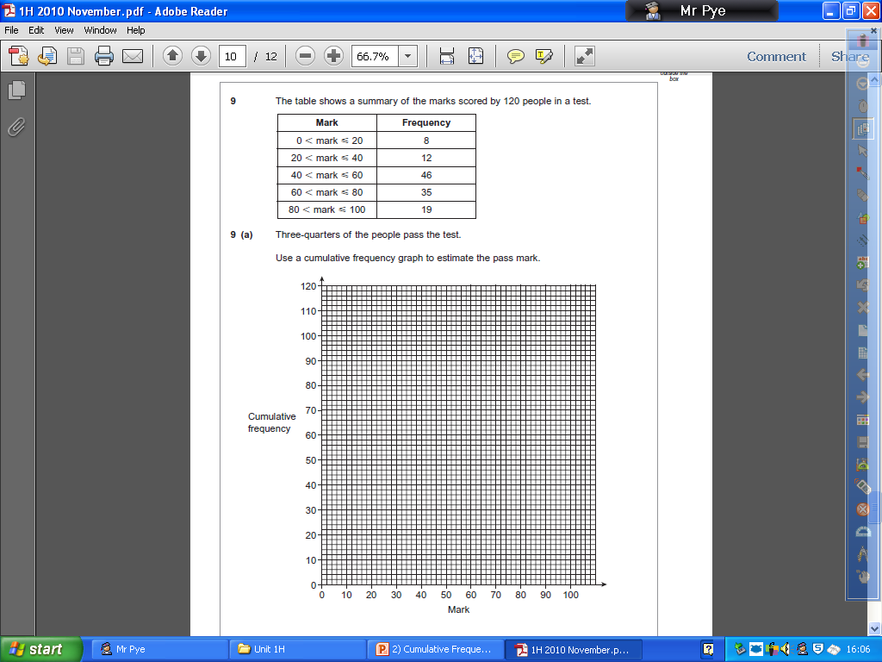
Plenary
(8)
(20)
(66)
(101)
(120)
¹/₄ of 120 = 30 (Lower Quartile)
Plot across at 30 (we want the mark that ³/₄ of the students are ABOVE)
→ This mark will have ¹/₄ of the students below it…
The pass mark could be estimated as 46 as ³/₄ of the students are above it…

Slide 9
Summary
We have learnt how to plot a Cumulative Frequency Curve
We have looked at interpretations of the curve
We will look at the Inter-quartile range next lesson, which uses a Cumulative Frequency curve

